Slide 1
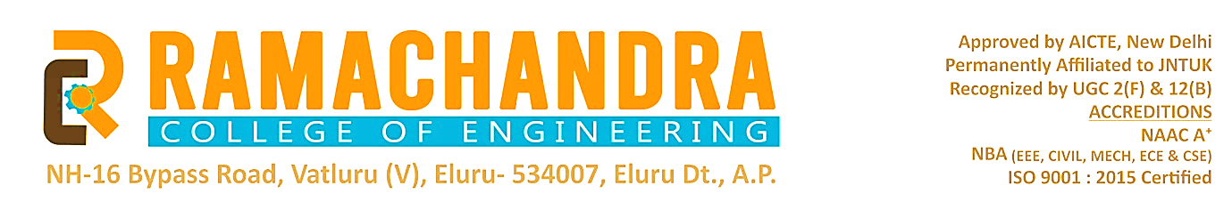
CERTIFICATE VALIDATION WITH SHA
Project team
R. Ganesh(20ME5A0514)
N. Mahalakshmi(19ME1A05D3)
V. Swetha(19ME1A05I2)
M. Srinivas(19ME1A05E1)
Guided by
Mr. B. Prasad Babu
Batch no:-
23

Slide 2

ABSTRACT
Lakhs of people getting Degree’s year after year, due to the lack of effective anti-forge mechanism In order to solve the problem of counterfeiting certificates, the digital certificate is used. The main aim of this project is to secure academic certificate and for accurate management and to avoid forge certificate. To achieve all this features, we are converting all certificates into digital signatures and this digital signature will be stored in server. The digital signature is in hexadecimal so it is not easy to hack. Here in this project we need provide two views for students and institutes both the view are separate we will provide. First they need to login and they can valid the certificates. The software technology we are used in this project to develop the frontend we use the tkinter. Middleware python we used to develop and digital signature, ash code was saved in local server.

Slide 3
INTRODUCTION
Advances in information technology, the wide availability of the Internet, and common usage of mobile devices have changed the lifestyle of human beings.
Here there are some illegal actives are done in world like certificate forge or creating fake document so we chose this project.
In certificate validation the user can check the certificate is original or not.
Here we give the two option was user to create digital signature, hash code for certificate and validation.

Slide 4
Existing system
The are there are two types in the existing system they are
Offline and online certificate validation.
In offline the certificate was validate the humans . We need give the certificate to another person they will validate our certificate.

Slide 5


Existing system
1.Document verification:
In this application you can upload the certificate and verification
2.certificate validation:-
This Application is used to verify the correctness of the Certificate produced by Candidate. This application is useful at the time of Interview in Government Department

Slide 6
limitations
Here there are two ways in certificate verification one is offline and another is online .
In offline it may take more time to verify
In online some application are used to verify only particular applications.
The user interface is not so good and to understand it may take more time
Here some application are used block chain based certificate validation it will have some limitation when we compare sha certificate validation the complexity is high and data was store in decentralization

Slide 7
Proposed system
In this certificate validation with sha there some difference between existing system and proposed system.
The user can verify certificate it is original or not.
Here the are organization can only create the digital signature for certificate
The data was stored in the centralization way

Slide 8
Expected output
The user can create the digital signature for that certificate and he can easy validate
Here the user interface is simple the user can easy to understand
separate view for institute and student.
The organization easily verify the certificate and can cerate the digital signature.

Slide 9
MODULES
Save Certificate with Digital Signature
Verify Certificate
User interface module
Database module

Slide 10
Software Requirements and Hardware requirements
Software requirements
IDE :- PyCharm or Visual Studios
Backend Language :- python.
Front end language :- Tkinter library in python
Operating System: windows 7 or more
Hardware requirements
Memory - 8GB RAM
Intel I5 Core Processor
Hard Disk : 250 Gb

Slide 11
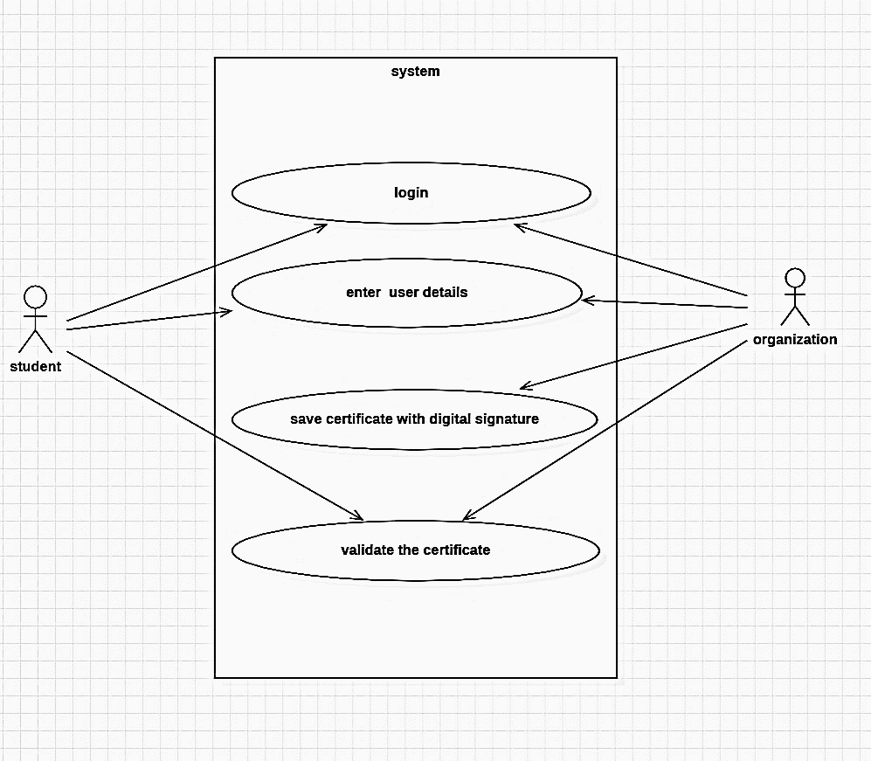
USE CASE DIAGRAM
Use case diagram for admin and organization

Slide 12
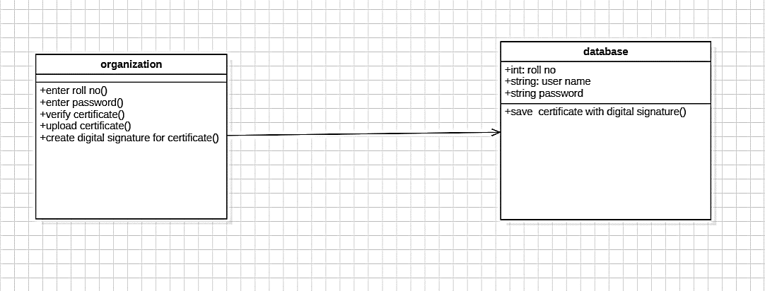
CLASS DIAGRAM
Class diagram for organization

Slide 13
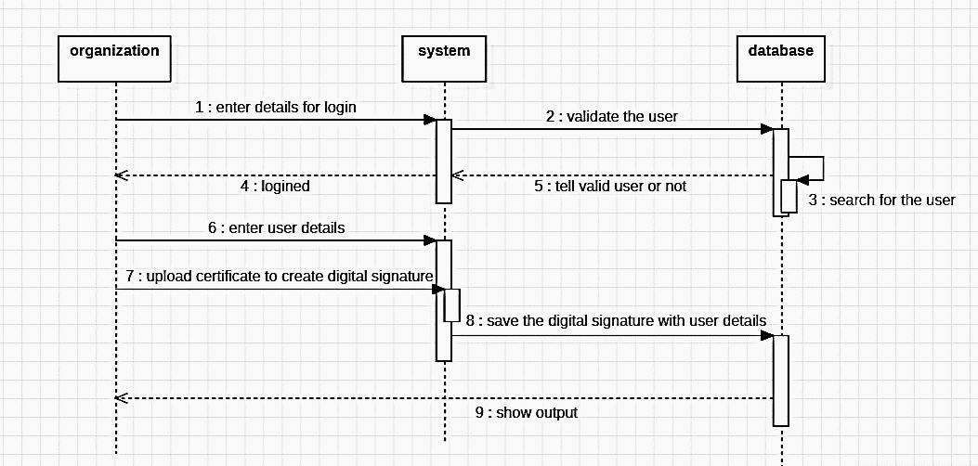
SEQUENCE DIAGRAM
Sequence diagram for organization

Slide 14
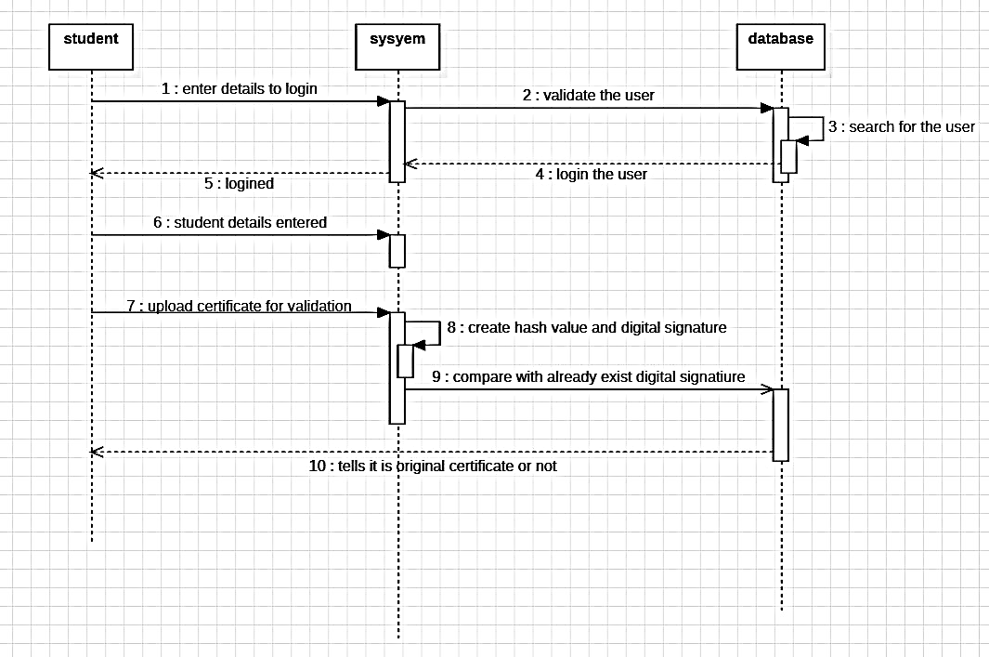
Sequence diagram for students.

Slide 15
OUTPUT

Slide 16
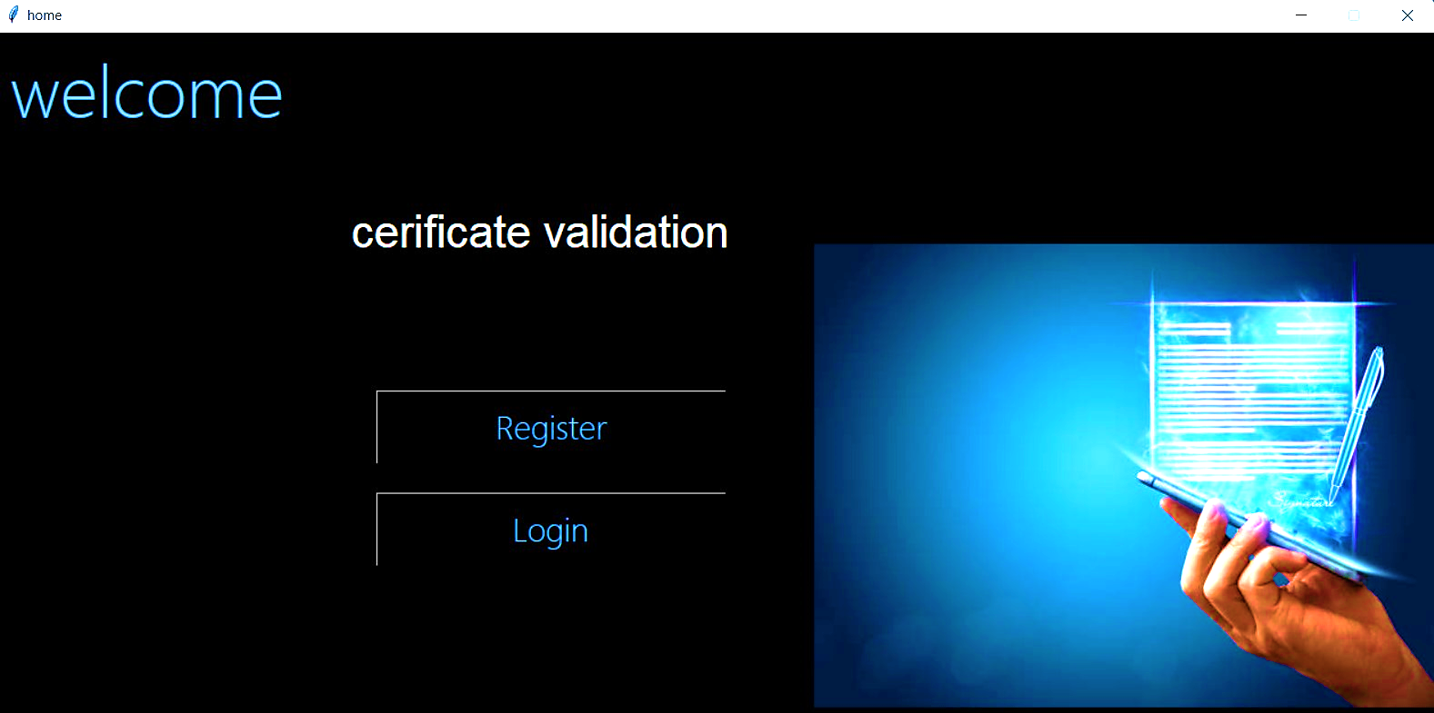
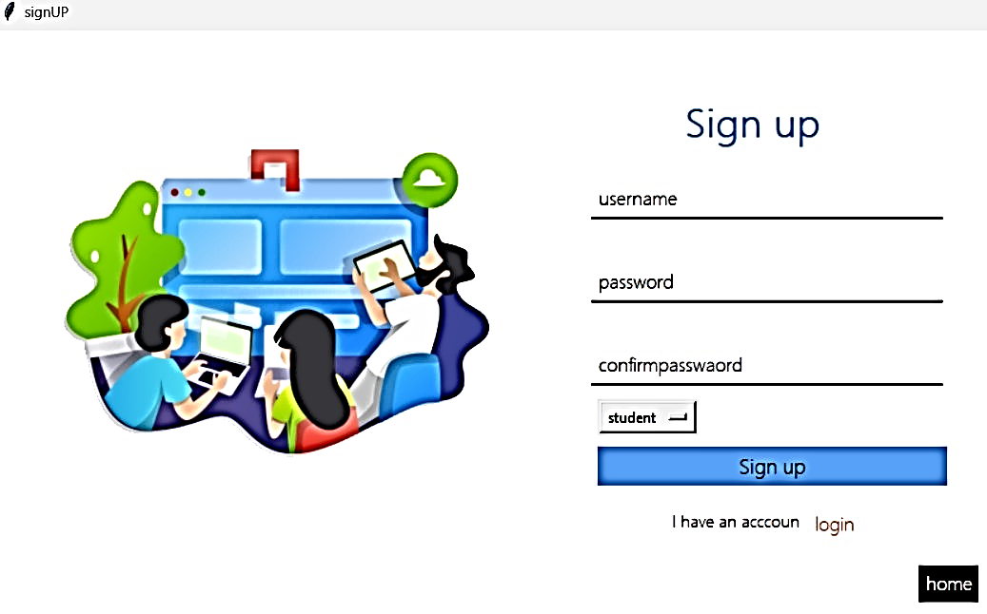
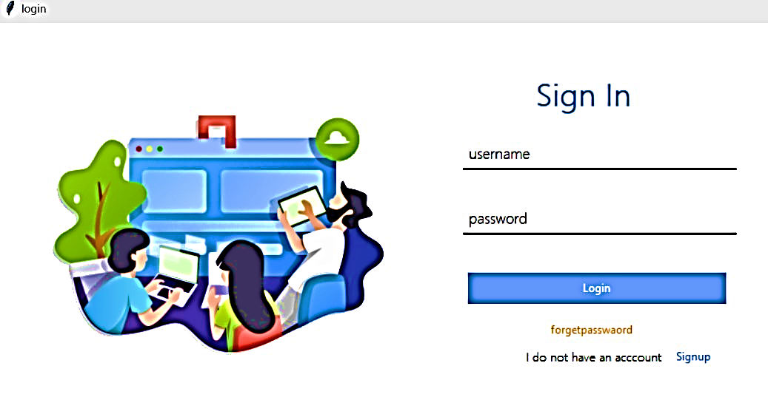
1.Home page
2.Registration page
3 .login page

Slide 17
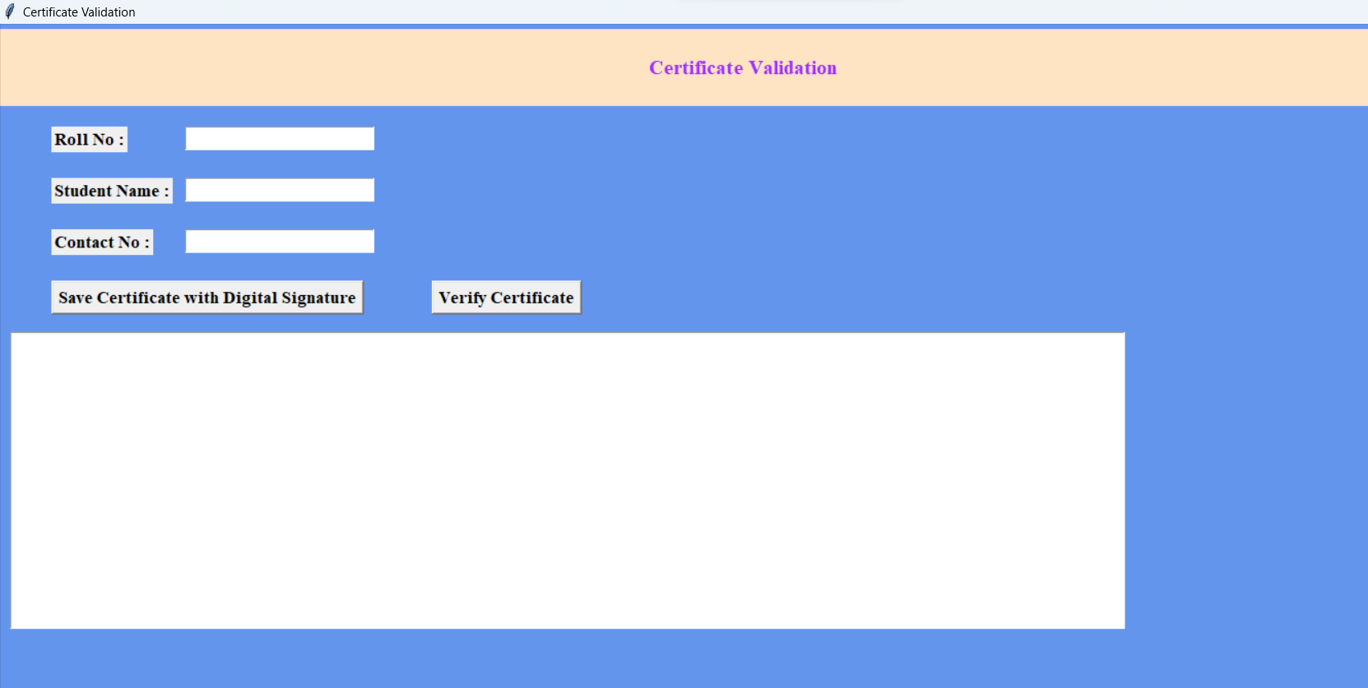
OUTPUT SCREENS FOR ORGANIZATION

Slide 18
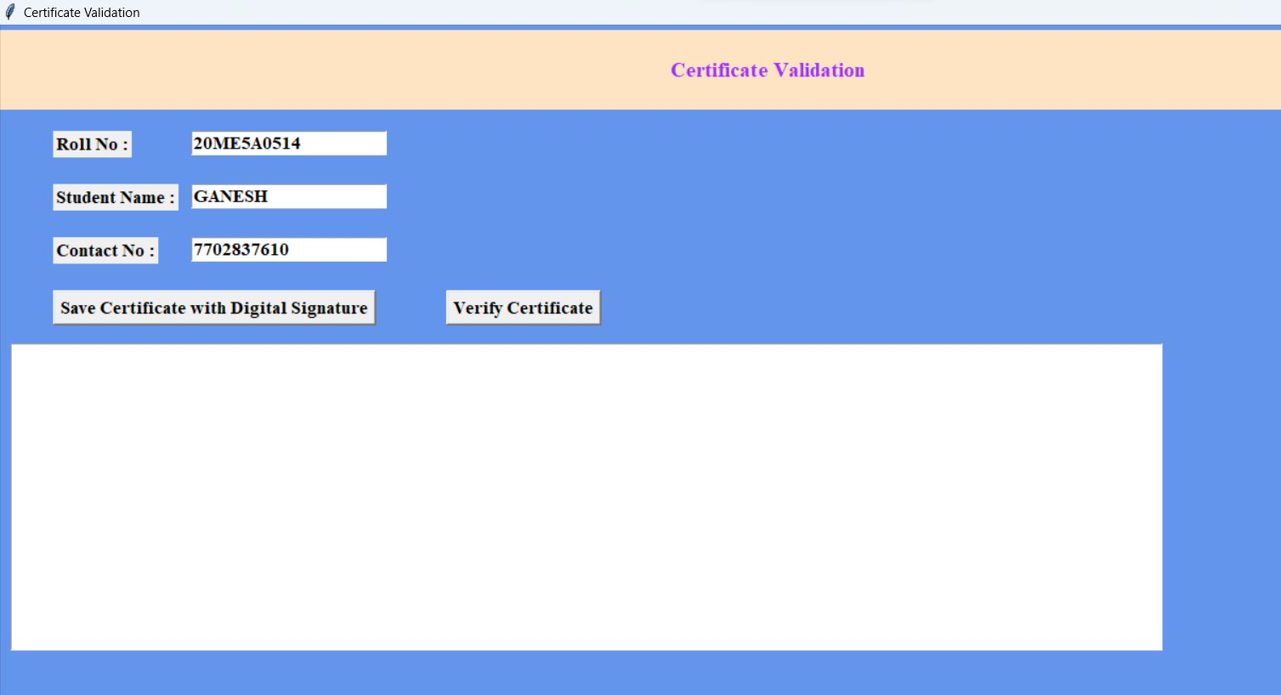
Creating digital signature and hash value
Step1
Enter roll no, student name, phone no

Slide 19
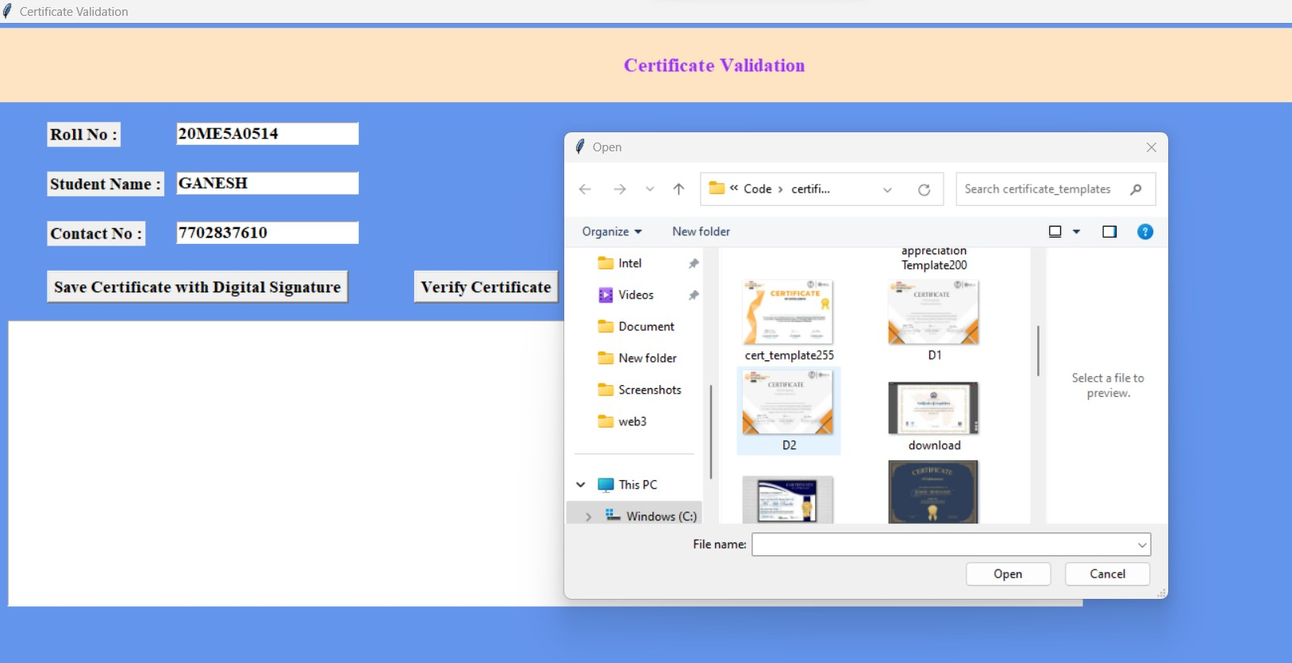
Step2
Click on save certificate

Slide 20
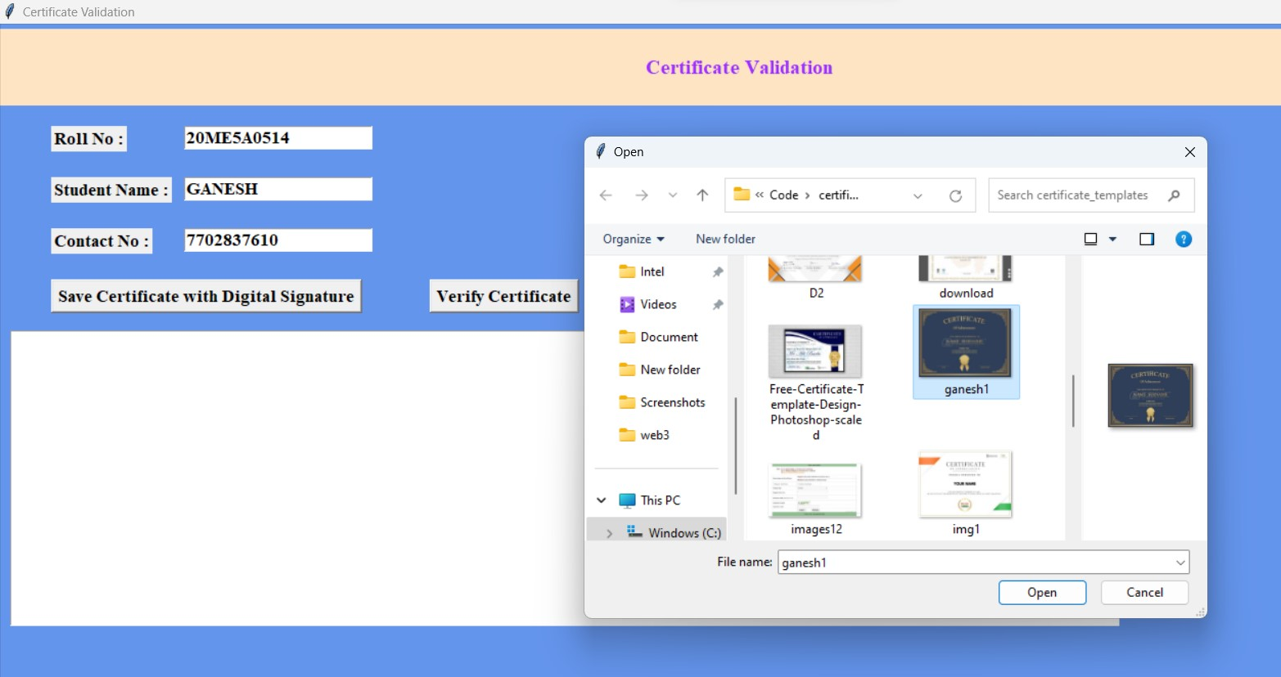
Step 3
Select certificate

Slide 21
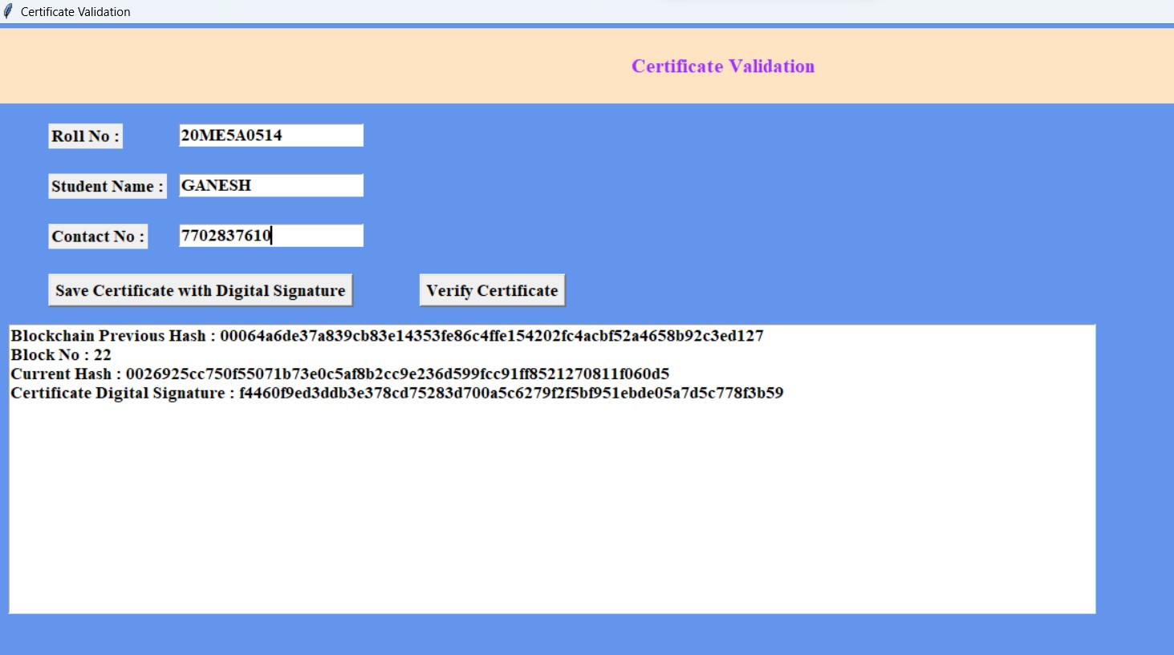
Step4
Click on save certificate with digital signature

Slide 22
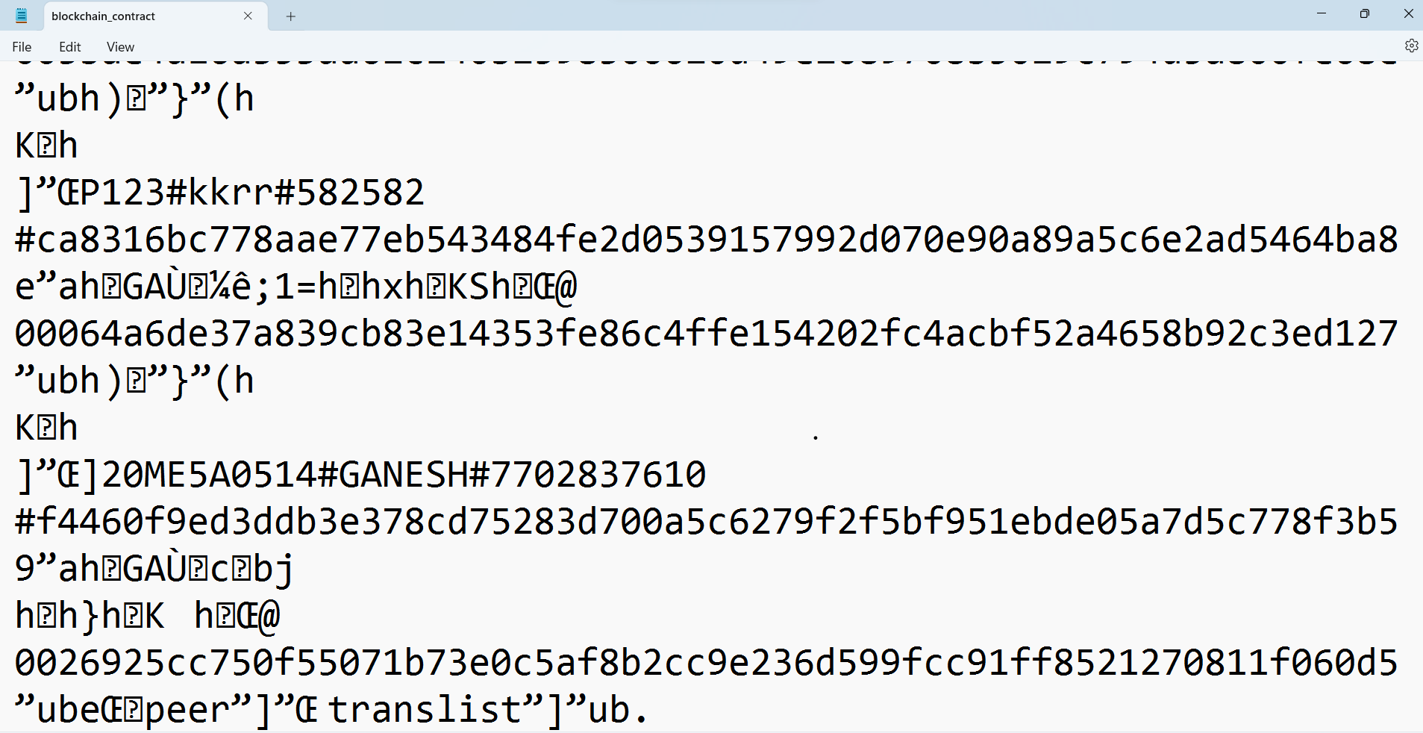
In this form digital signature will save

Slide 23
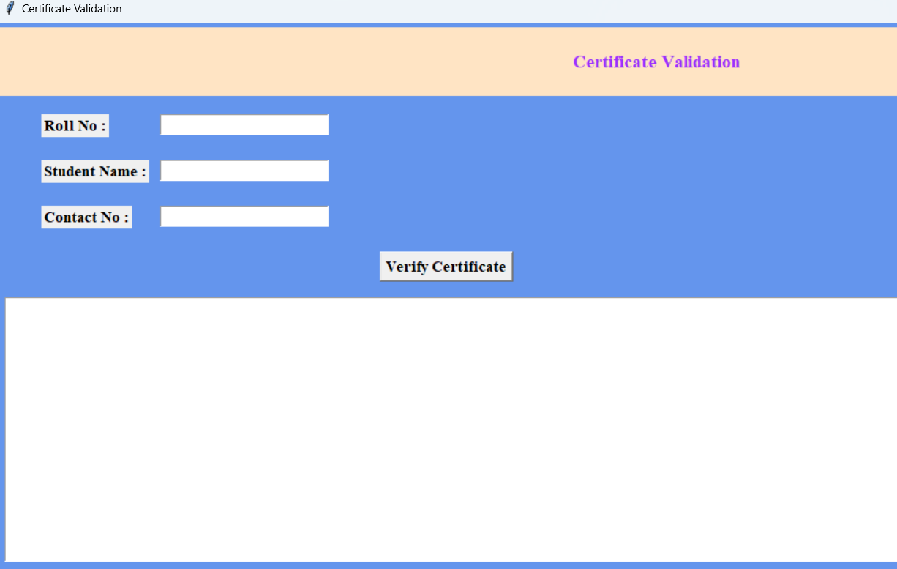
output for Students

Slide 24
Certificate validation
Step 1:
Fill the roll no, student name, phone number

Slide 25
Step2:- Click in verify

Slide 26
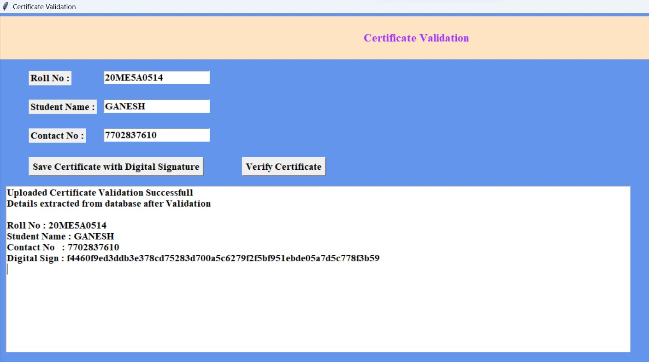
Step 3:
Now click on verify certificate

Slide 27
conclusion
Here the certificate validation with SHA is used to verify the certificates. The user can upload his certificate and create the digital signature ,hash code to that certificate it was created with the help of hashlib (SHA-256) library, he can verify the certificate with the help of digital signature. The certificate signature and hash code was stored in the database by comparing the original

Slide 28
Future Enhancement
Deploy our project in the cloud.
Add authentication field for the organization to know he/she is organized or trusted person.
Modified the GUI with some more graphics.
Here the centralization data center access permission option should given to the organization

Slide 29
REFERENCE
[1] Tengyu Yu, Blockchain operation principle analysis: 5 key technologies, iThome, https://www.ithome.com.tw/news/105374
[2] JingyuanGao, The rise of virtual currencies! Bitcoin takes the lead, and the other 4 kinds can't be missed. Digital Age, https://www.bnext.com.tw/article/47456/bitcoinether-li tecoin-ripple-differences-betweencryptocurrencies
[3] Smart contractswhitepaper, https://github.com/OSELab/learning-blockchain/blob/ master/ethereum/smart-contracts.md
[4] Gong Chen, Development and Application of Smart Contracts, https://www.fisc.com.tw/Upload/b0499306-1905- 4531-888a-2bc4c1ddb391/TC/9005.pdf
[5] Weiwei He, Exempted from cumbersome auditing and issuance procedures, several national junior diplomas will debut next year.iThome， https://www.ithome.com.tw/news/119252
[6] Xiuping Lin, “Semi-centralized Blockchain Smart Contracts: Centralized Verification and Smart Computing under Chains in the EthereumBlockchain”,Department of Information Engineering, National Taiwan University, Taiwan, R.O.C., 2017.

